Slide 1
Congruency
J. Wilson

Slide 2
Congruence
Congruent shapes have the same shape and size. They can fit exactly on top of each other.
If something is flipped, rotated or translated (slide) then it is still congruent.
If something is enlarged, shrunk or stretched it is no longer congruent.
✓
✓
✓
✗
✗
✗

Slide 3
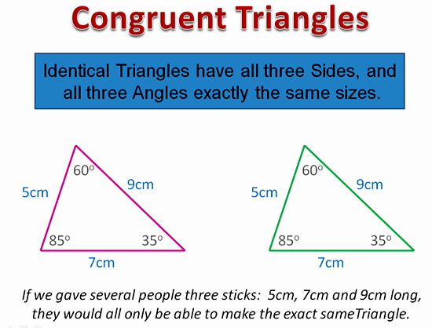
So what is the point? Why do we care about congruent triangles?

Slide 4
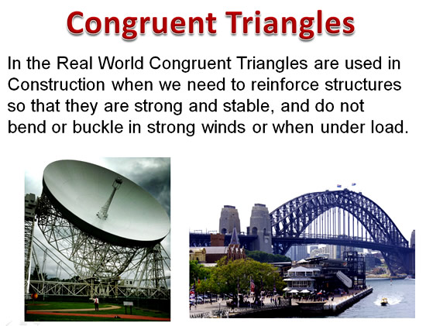

Slide 5
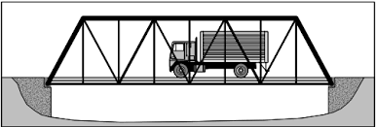
Your company is building a steel truss bridge.
To make the bridge, you need to weld together 14 identical triangles from steel beams. You already have 1 triangle made up as below.
What information do you need to use to make 13 more triangles that are identical to this one?
Can you make a “congruent” triangle with only some of the information?
7m
34º
7m
73º
73º
4m

Slide 6
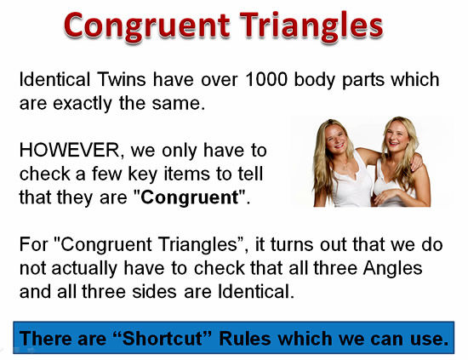

Slide 7
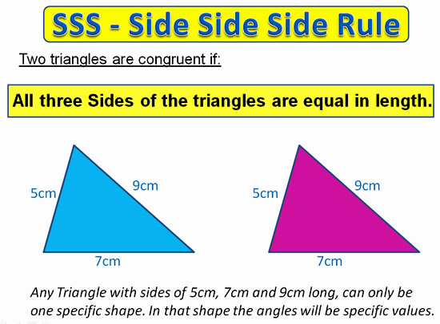
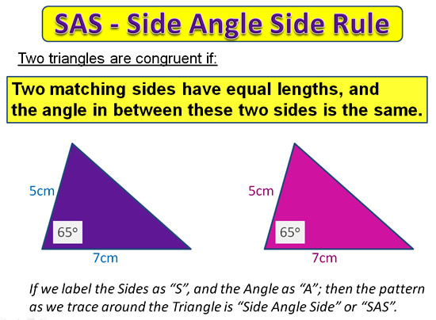
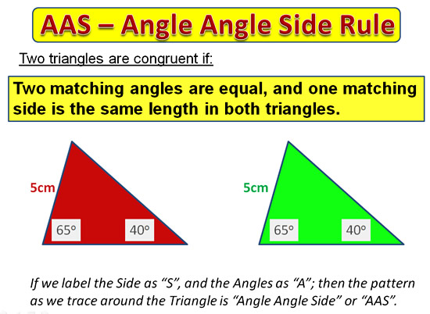
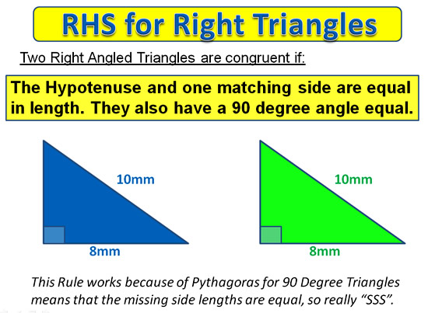

Slide 8
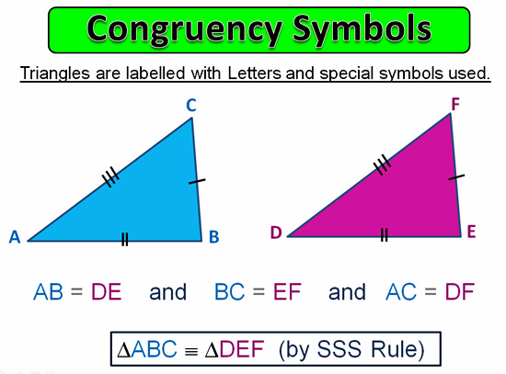

Slide 9
Topic : Congruency
24
7
30
Date
EQ : How do we know if two triangles are congruent?
Congruent triangles have the same shape and size (they can be rotated, flipped or translated). We don’t need to measure everything to prove something is congruent.
SSS -- Side, Side, Side rule.
If the lengths of all the sides match
SAS -- Side Angle Side Rule.
If two sides have equal lengths and the angle between these sides is the same.
AAS – Angle Angle Side Rule
Two matching angles are equal and a matching side is equal in length.
RHS – Right Angle Hypotenuse Rule
Right-Angled Triangles are congruent if the hypotenuse and one pair of matching sides are equal in length.

Slide 10
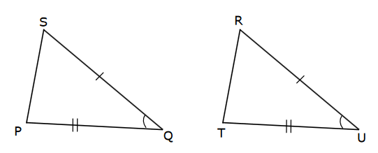
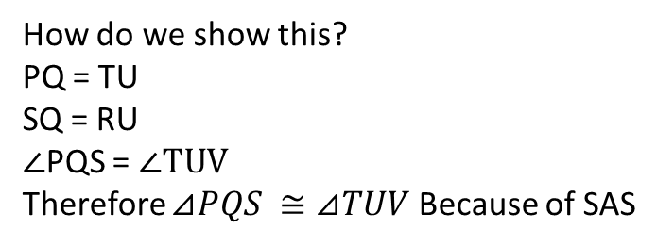
Time to try some.
Can we prove these triangles are congruent?
Yes
Why?
Because of the SAS rule
How do we show this?
PQ = TU
SQ = RU
$∠$PQS = $∠TUV$
Therefore $⊿PQS ≅⊿TUV$ Because of SAS

Slide 11
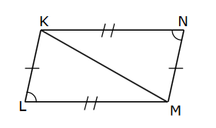
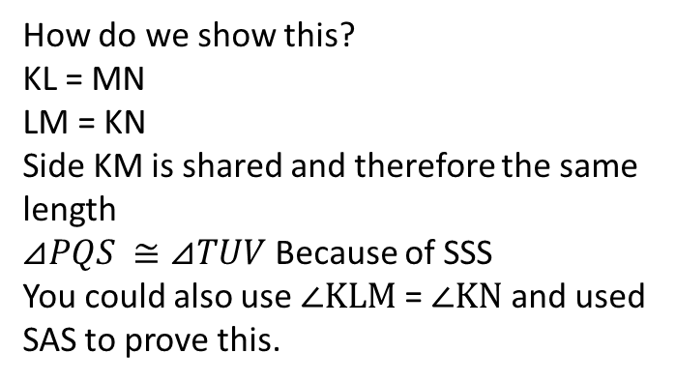
Time to try some.
Can we prove these triangles are congruent?
Yes
Why?
Because of either the SAS rule or SSS rule
How do we show this?
KL = MN
LM = KN
Side KM is shared and therefore the same length
$⊿PQS ≅⊿TUV$ Because of SSS
You could also use $∠KLM$ = $∠KN$ and used SAS to prove this.

Slide 12
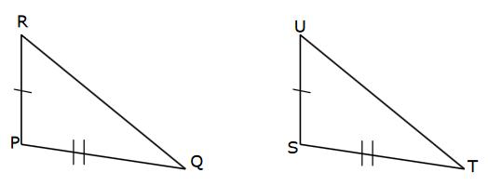
Can we prove these triangles are congruent?
No
Why?
We only know 2 sides are the same – we need 1 more side or the angle between them to PROVE congruency

Slide 13
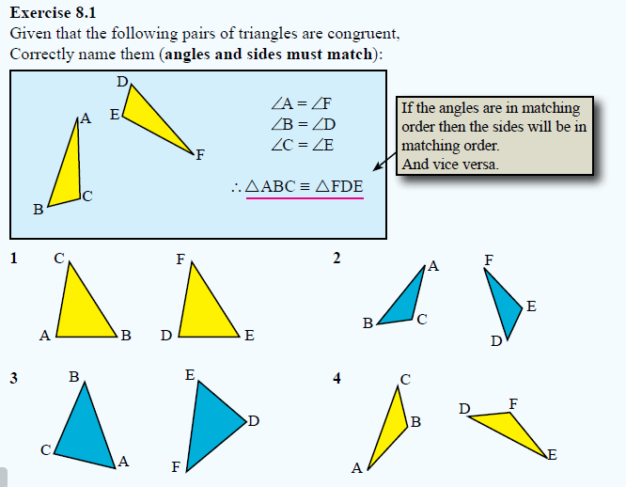
Page 104

Slide 14
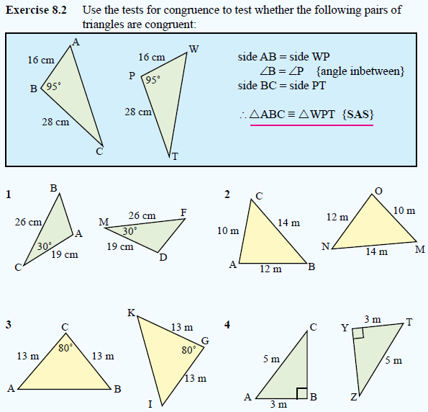
Page 105

Slide 15
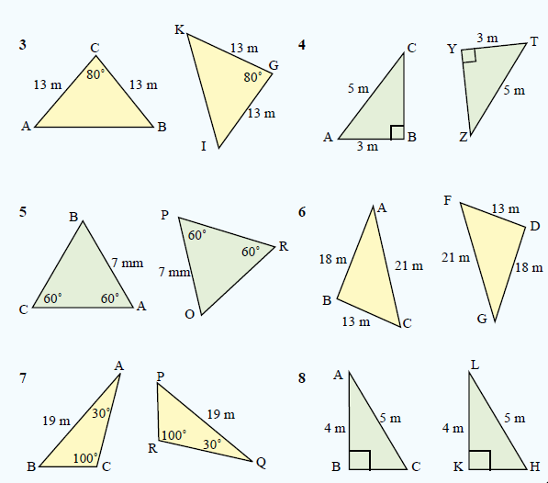
Page 105

Slide 16
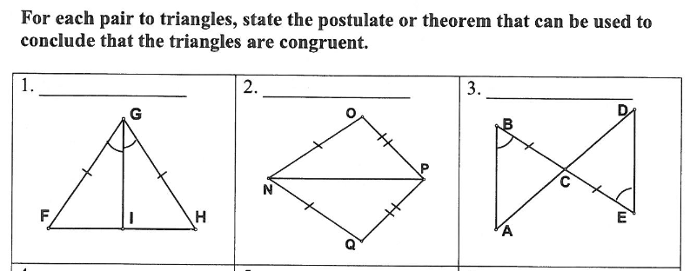
EXIT PASS

